Slide 1



Data transfer policies to enable MSME ecommerce
Dr. Kati Suominen
Founder and CEO, Nextrade Group; Technical Director, eTrade Alliance
13 May 2022

Slide 2
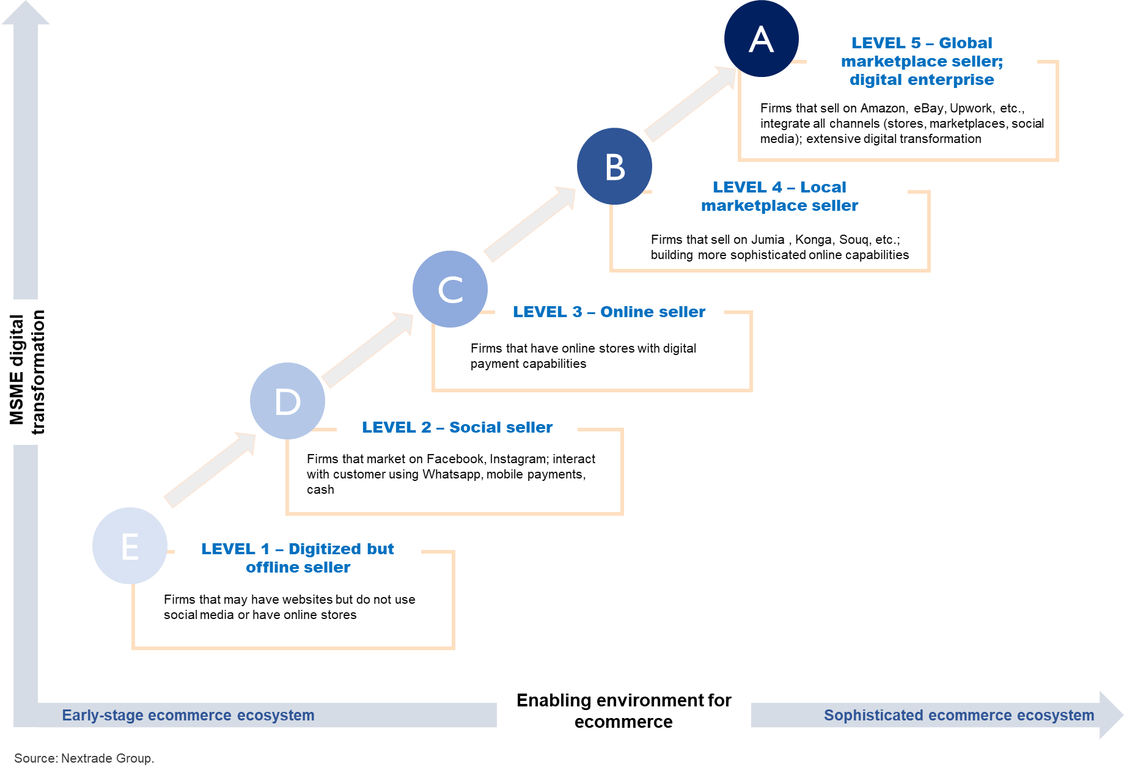
Making more Ds and Cs into As and Bs → requires MSME digital transformation, better enabling environment for ecommerce

Slide 3
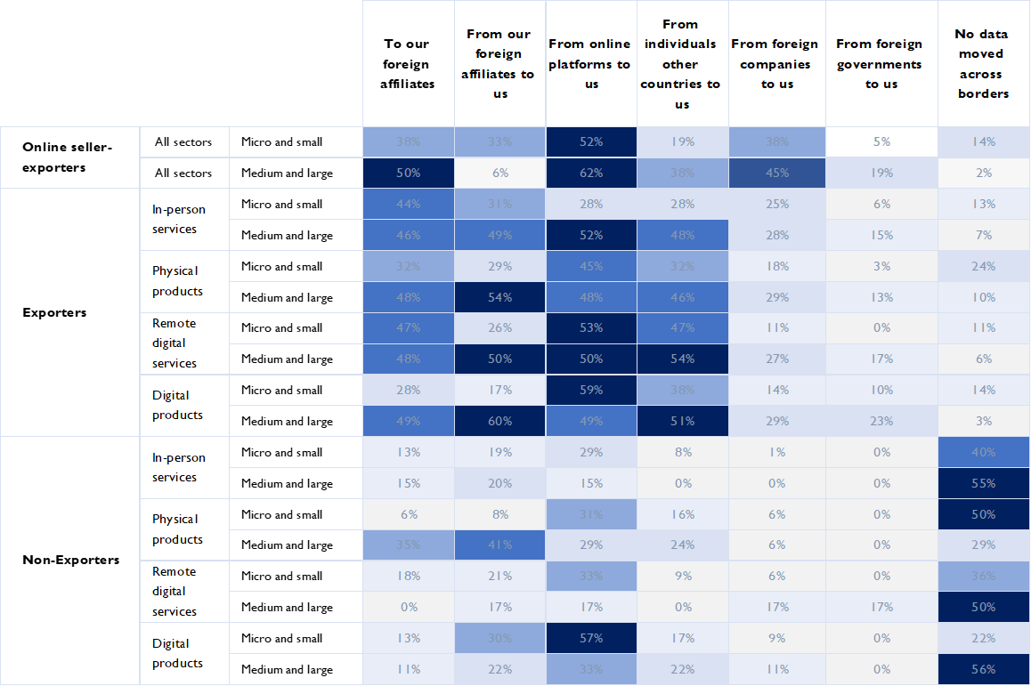
Firms and especially online seller - exporters export and import data:
data transfer is critical for MSMEs that export using ecommerce
Source: Suominen and Vambell (2021)

Slide 4
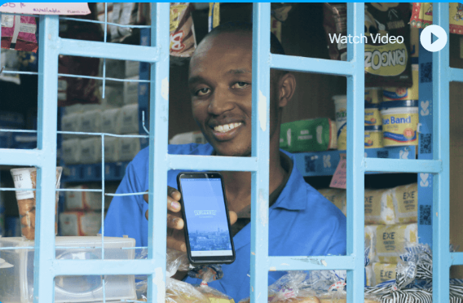


Data use cases among African SMEs
MARKETFORCE – East and West Africa
Enables manufacturers, distributors, retailers, financial service providers, and sales agents to source, order, and pay for goods and services
Uses data:
    Understand needs and challenges across various value chains
Tailor offerings to meet customers’ preferences
Identify and address operational inefficiency
Forecast demand and to provide financial services, including credit or remitting commissions.
AI engine allows it to access datasets and inputs that are the foundation for predictive analytics
HIBRET - Ethiopia
Financial services for companies, non-profits, and individuals
385 branches connected to HQ data center
Transactions captured on Oracle FLEXCUBE
Uses data:
    Assess asset quality and repayment schedules
    Protect against fraud → flag a suspicious account
    Ideally move to cloud-base s storage on remote service
“Data is like gas or petroleum for us” - Melaku Kebede, CEO
https://www.allianceforetradedevelopment.org/msme-data-use-cases

Slide 5
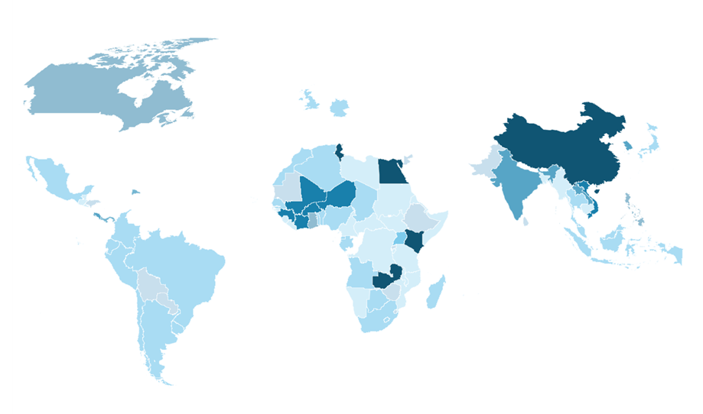
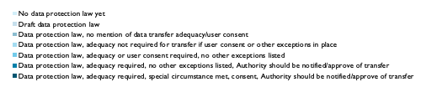
Different models: «fragmentation» around the world
Source: Suominen and Vambell (2021)

Slide 6
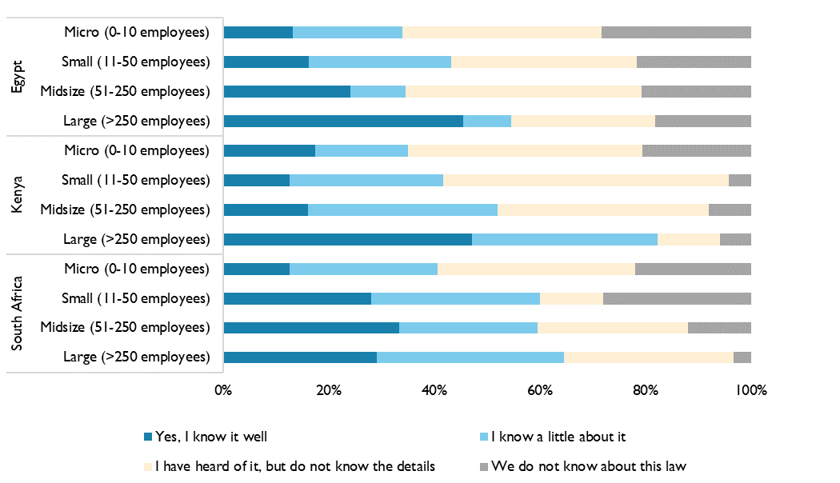
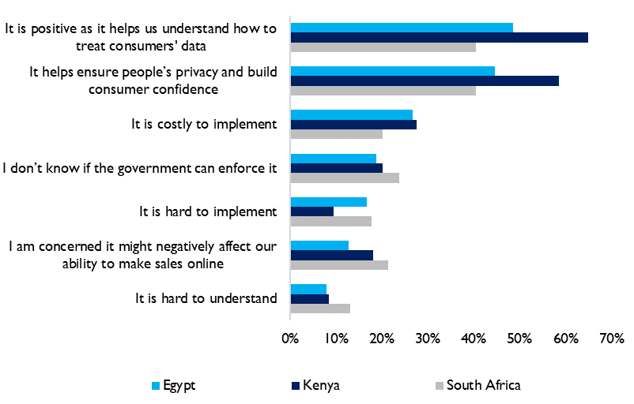
Surveyed African firms find regulations as clarifying –
but especially small firms still know only a little about regulations
African firms’ views on data privacy and transfer regulations in their countries
African firms’ knowledge of data privacy and transfer regulations in their countries, by firm size
Source: Suominen and Vambell (2021)
https://www.allianceforetradedevelopment.org/data-transfer-in-africa

Slide 7
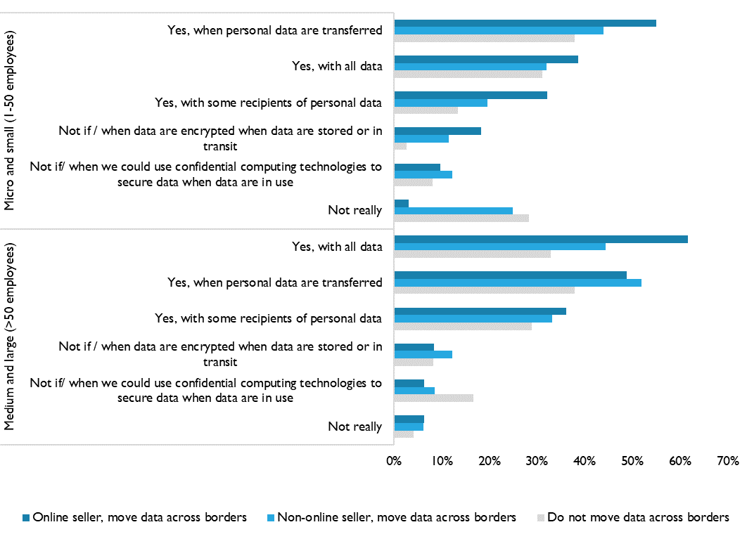
Surveyed African firms do not take data transfer to third parties lightly
“Are you concerned about how a recipient of the data you transfer uses it?”
https://www.allianceforetradedevelopment.org/data-transfer-in-africa

Slide 8
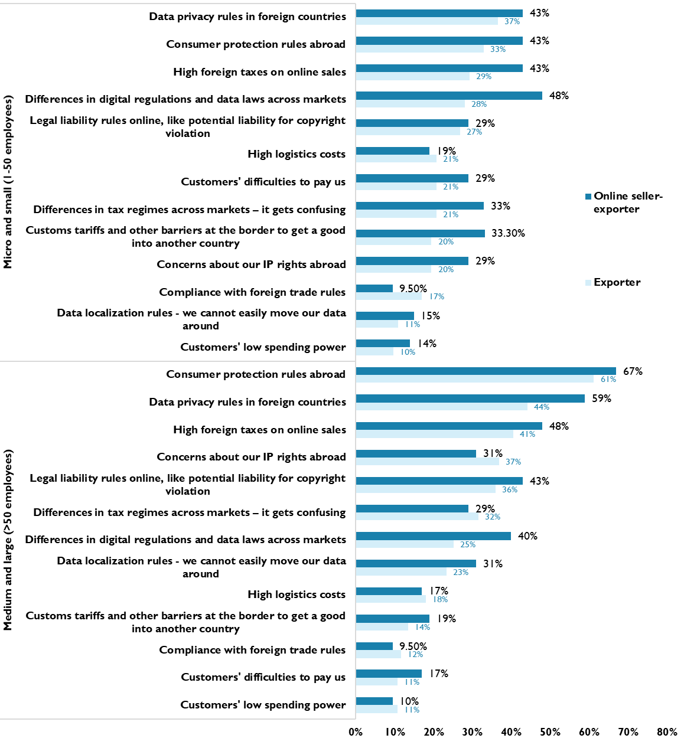
African firms’ main perceived policy challenges in exporting products or services online –
worry about
1. compliance with foreign data privacy rules and
2. regulatory fragmentation
Source: Suominen and Vambell (2021)
https://www.allianceforetradedevelopment.org/data-transfer-in-africa

Slide 9
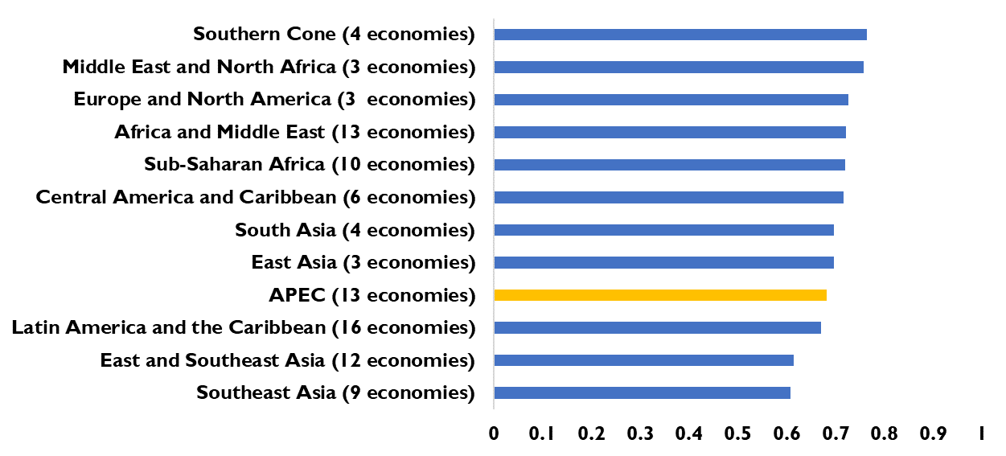
Fragmentation: Similarities (vs. Differences) in digital regulations in APEC
Similarity index of digital regulations
Pairwise similarity index – APEC economies
Source: Suominen, Vambell, Furtek (2021)

Slide 10
Promote trade agreements and integration – blueprints are well in place
Source: Suominen (2021)

Slide 11
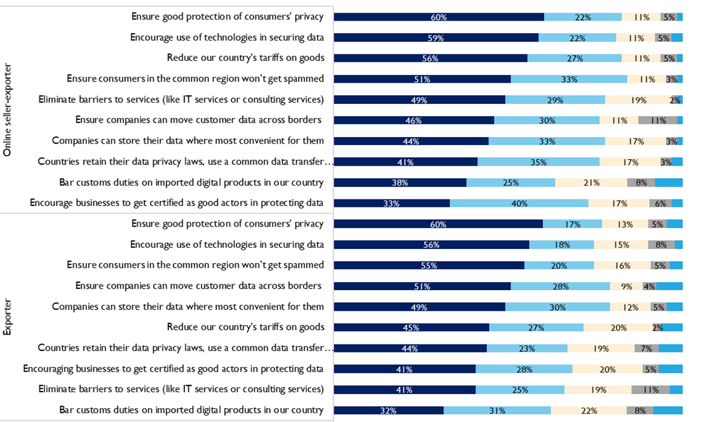
Surveyed African firms see CPTPP- and USMCA-style digital trade rules positively for Africa
https://www.allianceforetradedevelopment.org/data-transfer-in-africa
Source: Suominen and Vambell (2021)

Slide 12
 | Trade in goods | Trade in all services | Trade in digitally deliverable services
Distance | -0.230*** | -0.697*** | -0.809***
 | (0.022) | (0.020) | (0.026)
Common language | -0.328 | 0.442*** | 0.378***
 | (0.058) | (0.035) | (0.047)
Colonial relationship | 0.267*** | 0.010 | -0.219***
 | (0.061) | (0.035) | (0.048)
Share border | 1.265*** | 0.248*** | 0.020
 | (0.053) | (0.039) | (0.053)
PTA covering trade in goods | 0.567*** | 0.027 | -0.697***
 | (0.055) | (0.129) | (0.129)
PTA covering trade in services | 1.331*** | 1.323*** | 1.616***
 | (0.176) | (0.258) | (0.354)
PTA covering goods and services | 0.551*** | 0.590*** | 0.265***
 | (0.054)*** | (0.072) | (0.076)
PTA covering goods, services, and ecommerce | 0.964*** | 0.564*** | 0.656***
 | (0.213) | (0.104) | (0.131)
Exporter-year fixed effects | YES | YES | YES
Importer-year fixed effects | YES | YES | YES
N | 109,298 | 22,306 | 21, 918
Pseudo R-sq | 0.944 | 0.903 | 0.898
Overall, positive trade effect from from «Super PTAs» like CPTPP - with digital trade, on trade in goods, services, digitally deliverable services
*** significant at 1% level; ** significant at 5% level; * significant at 10% level. Standard errors in parentheses.
Source: Suominen (2021)

Slide 13
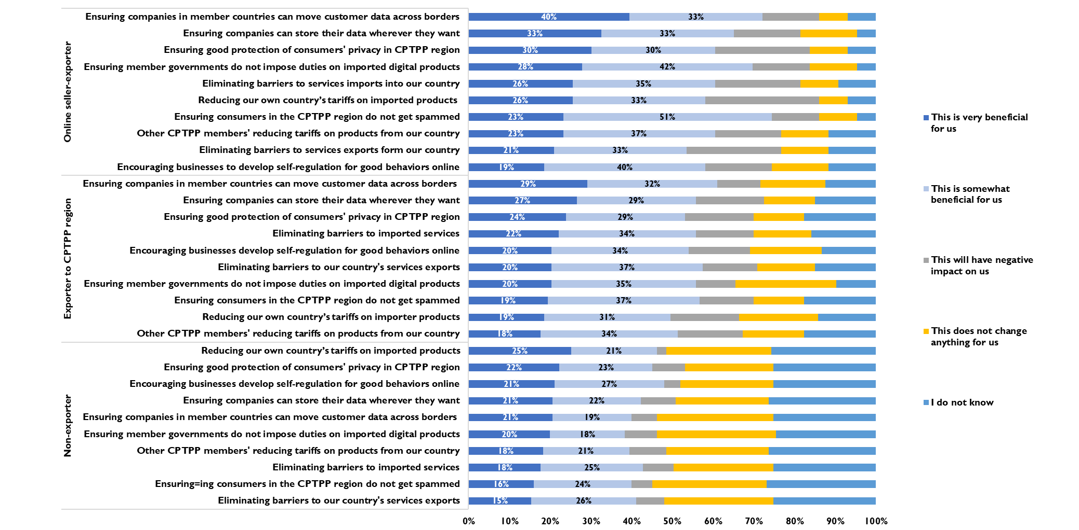
One possibility: trade deals with free data transfer provisions increasingly prominent in trade deals
Source: Suominen (2021)

Slide 14
Proposals
Strategy 1: Convergence - Ensure that national data privacy laws are more compatible
Strategy 2: Choice: Enable firms, particularly online sellers, to use and move data across borders safely and with ease. Templates:
              - Asia-Pacific Economic Cooperation (APEC) Cross-Border Privacy Rules (CBPR) system
              - Comprehensive and Progressive Agreement for Trans-Pacific Partnership (CPTPP) (2018)
              - United States-Mexico-Canada Agreement (USMCA), which endorsed the CBPR system (2020)
              - Digital Economy Partnerships Agreement (DEPA), with Chile, New Zealand, Singapore (2020)

Slide 15
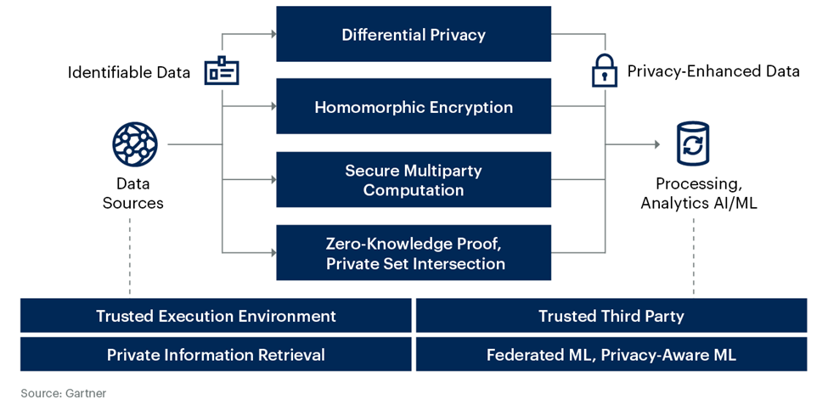
Privacy-Enhancing Computation Techniques
Forecasts: by 2025, 50% of large organizations will seek to adopt privacy-enhancing computation for processing data in multiparty data analytics
When fashioning data transfer policies, African governments could also support firms in piloting, adopting, and using these emerging technologies
Source: Gartner.

Slide 16
Thank you

